Slide 1



Fire Safety Management System
Ensuring robust fire safety is paramount for every organization. This presentation introduces a comprehensive web-based application designed to streamline and enhance fire safety protocols.

Slide 2

INTRODUCTION
Revolutionizing Fire Safety Management
The Fire Safety Management System (FSMS) is an advanced, web-based platform engineered to provide a centralized and efficient approach to managing all aspects of fire safety within an organization.
From incident tracking to chemical management and comprehensive reporting, the FSMS is built to empower safety officers and decision-makers with the tools they need to maintain a secure environment.

Slide 3
PROBLEM STATEMENT
Addressing Current Challenges in Fire Safety
Fragmented Data
Manual Processes
Lack of Real-time Insights
Current systems often involve disparate data sources, leading to inconsistencies and difficulties in accessing critical safety information quickly.
Reliance on manual logging and tracking for incidents and hazardous materials is prone to human error and inefficiency.
Without real-time data, organizations struggle to identify emerging risks, respond effectively to incidents, and make informed safety decisions.

Slide 4

OBJECTIVES
Our Goals for Enhanced Safety
Centralize Data
Provide a single, unified platform for all fire safety-related information, ensuring accuracy and accessibility.
Improve Efficiency
Automate key safety management processes, reducing manual effort and potential for error.
Enhance Decision-Making
Deliver real-time analytics and comprehensive reports to support proactive safety strategies.
Ensure Compliance
Facilitate adherence to fire safety regulations and standards with robust tracking and reporting features.

Slide 5
SYSTEM FEATURES
Key Functionalities at a Glance
Chemical Management
Interactive Dashboard
Incident Management
Monitor hazardous chemicals, their storage locations, and expiration dates to prevent risks.
Real-time overview of incidents, safety metrics, and compliance status.
Log, track, and analyze fire incidents, their causes, and resolutions for continuous improvement.
Location Management
Advanced Reports
Organization & Staff
Generate detailed, customizable reports on incidents, safety status, and compliance for audit and review.
Effectively manage and map all organizational locations, enhancing emergency response planning.
Maintain organizational structure and staff details, including safety roles and training records.

Slide 6




TECHNOLOGY STACK
Built on Robust and Scalable Foundations
Modern Web Frameworks
Secure Database
Cloud-Native Architecture
Ensuring a responsive and intuitive user experience across all devices.
Reliable and encrypted storage for all critical safety data.
Scalability, high availability, and seamless integration with existing IT infrastructure.

Slide 7
BENEFITS
1
2
Enhanced Safety Culture
Operational Efficiency
Foster a proactive approach to safety, reducing risks and protecting assets.
Streamline workflows, save time, and reduce administrative burdens for safety teams.
3
4
Regulatory Compliance
Cost Reduction
Easily meet and demonstrate adherence to industry safety standards and regulations.
Minimize potential losses from incidents and reduce insurance premiums through improved safety records.

Slide 8
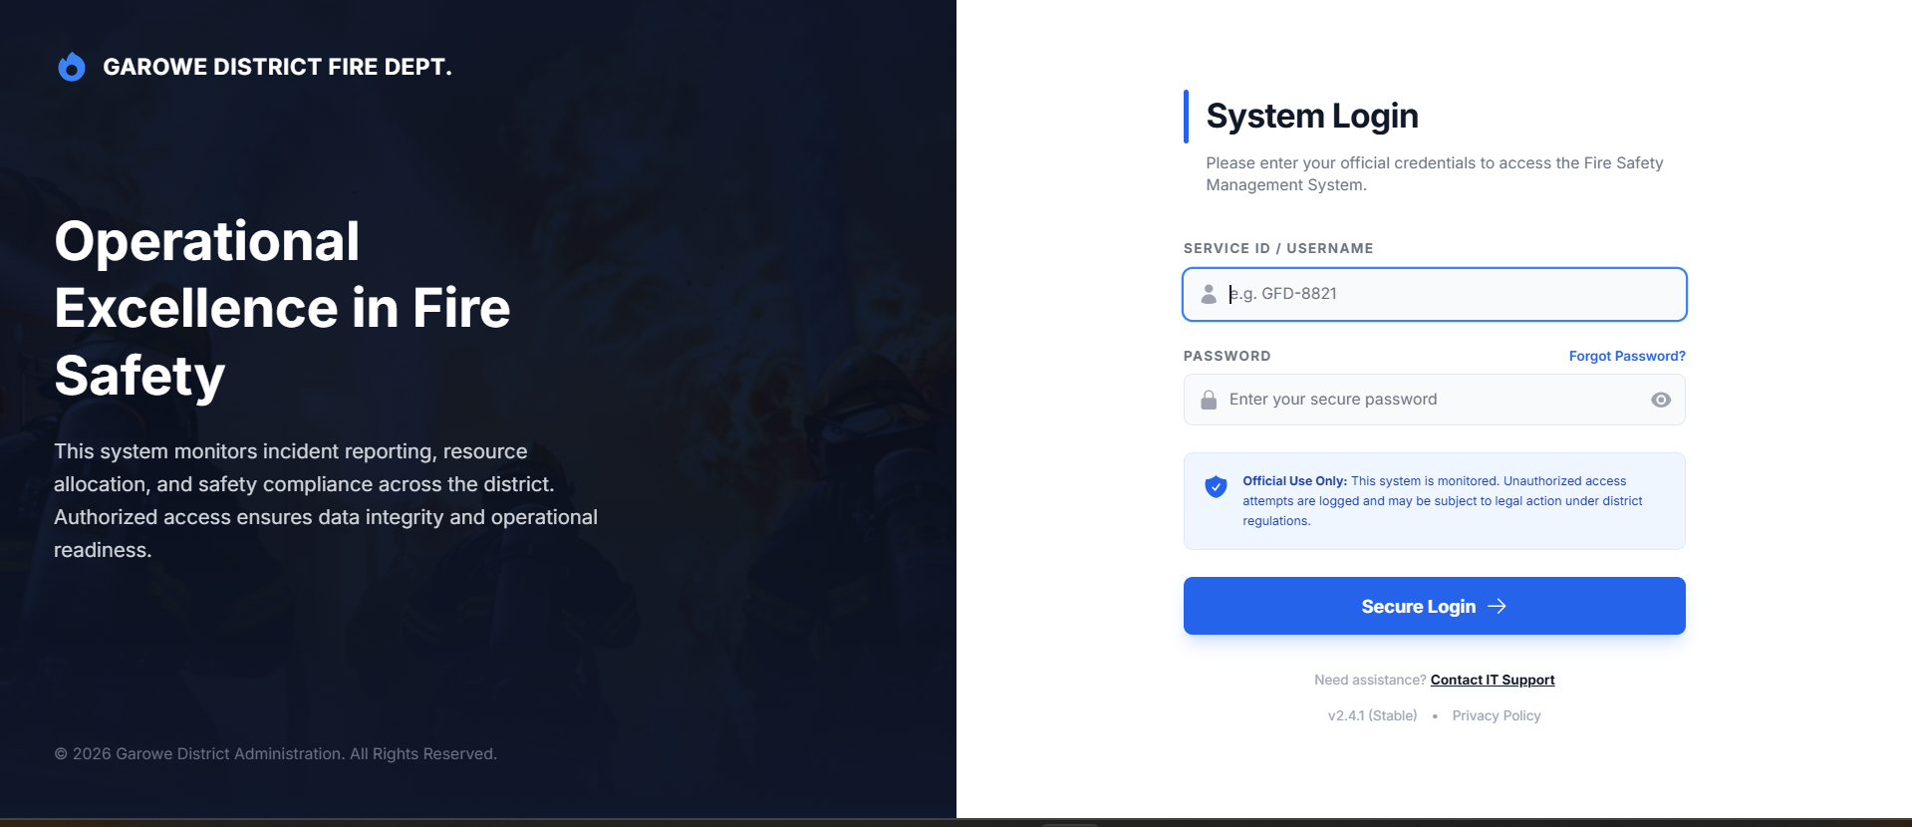
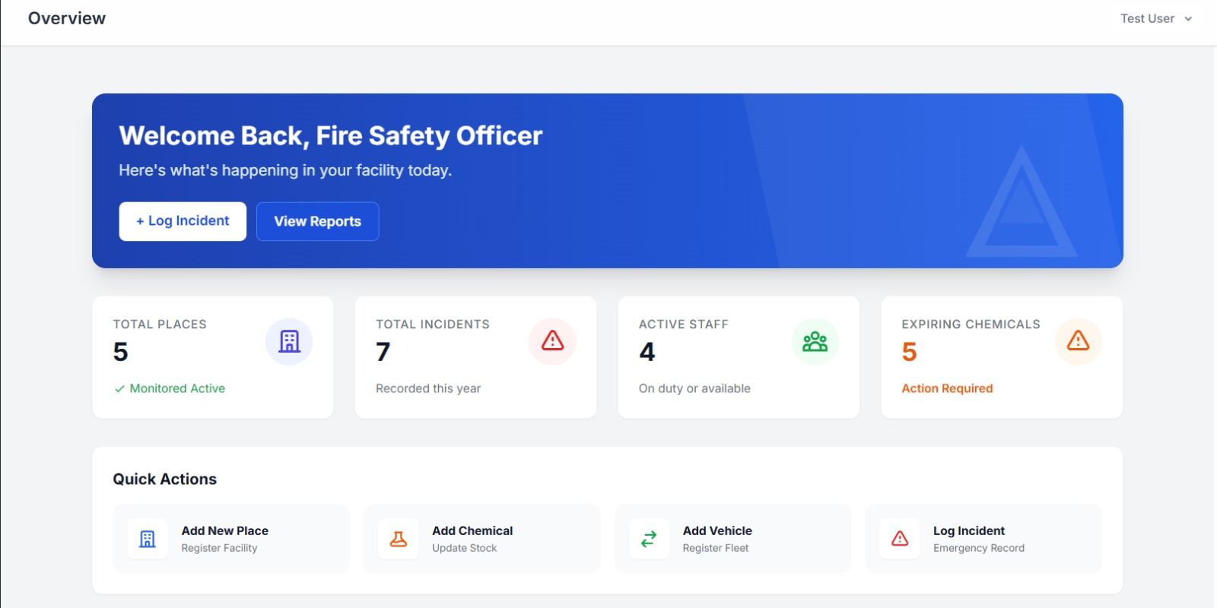
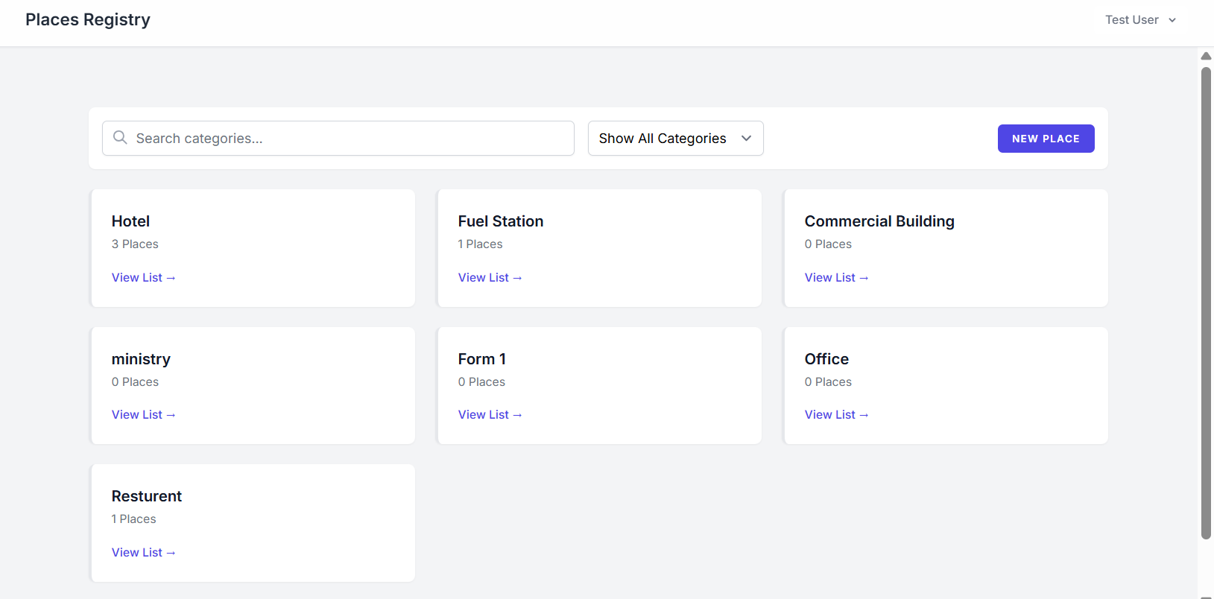
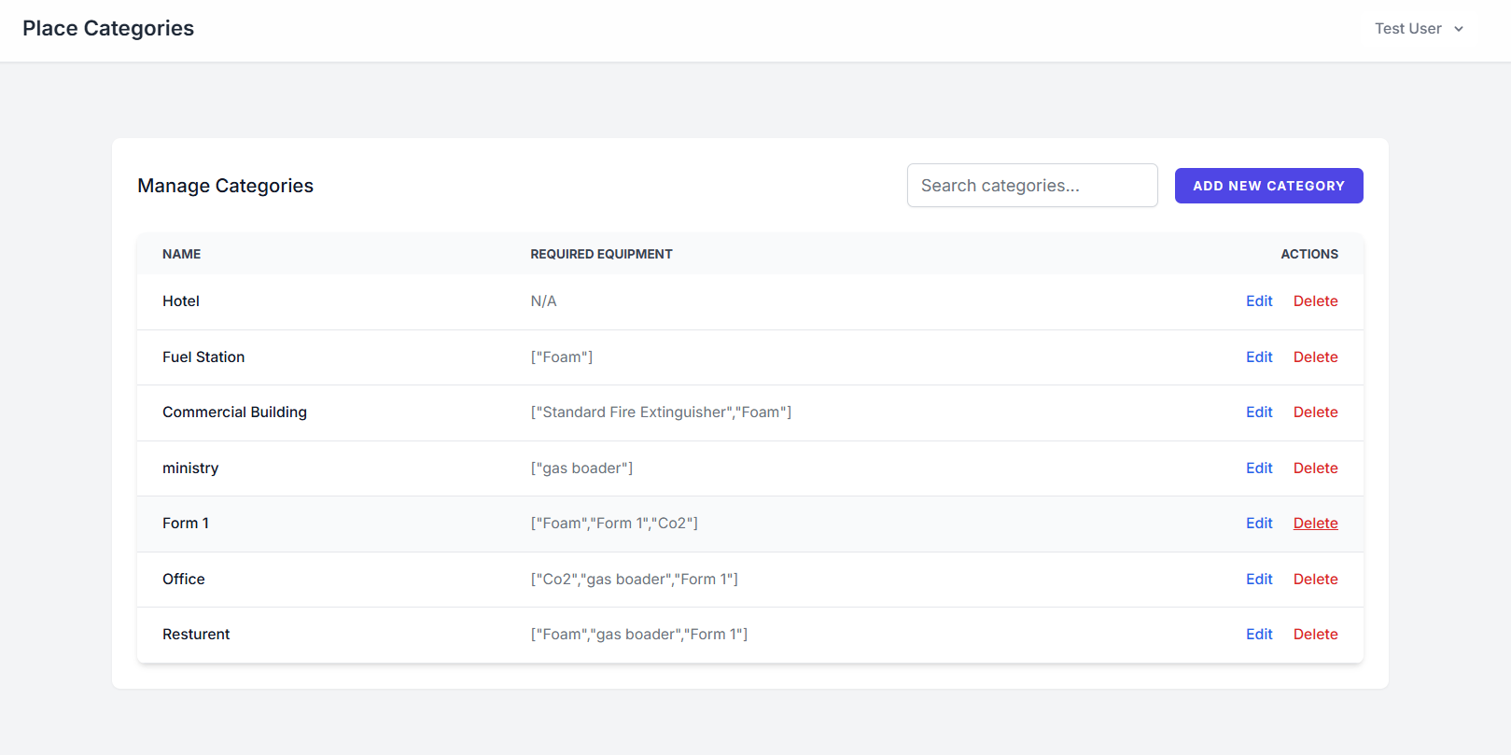
SCREENSHOTS
Login/singup
Dashboard
Places Registery
Places Categories

Slide 9
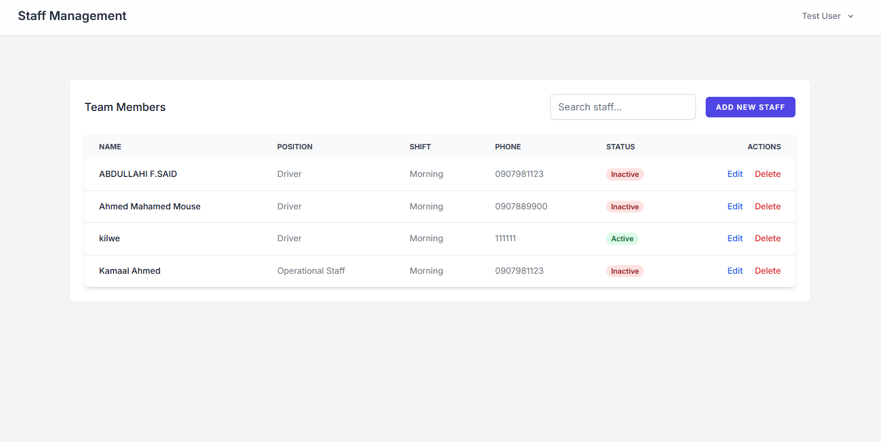
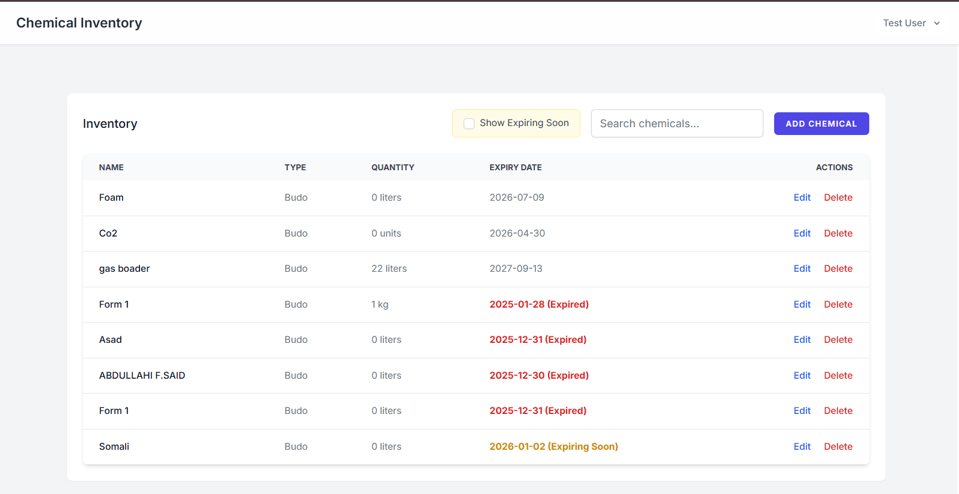
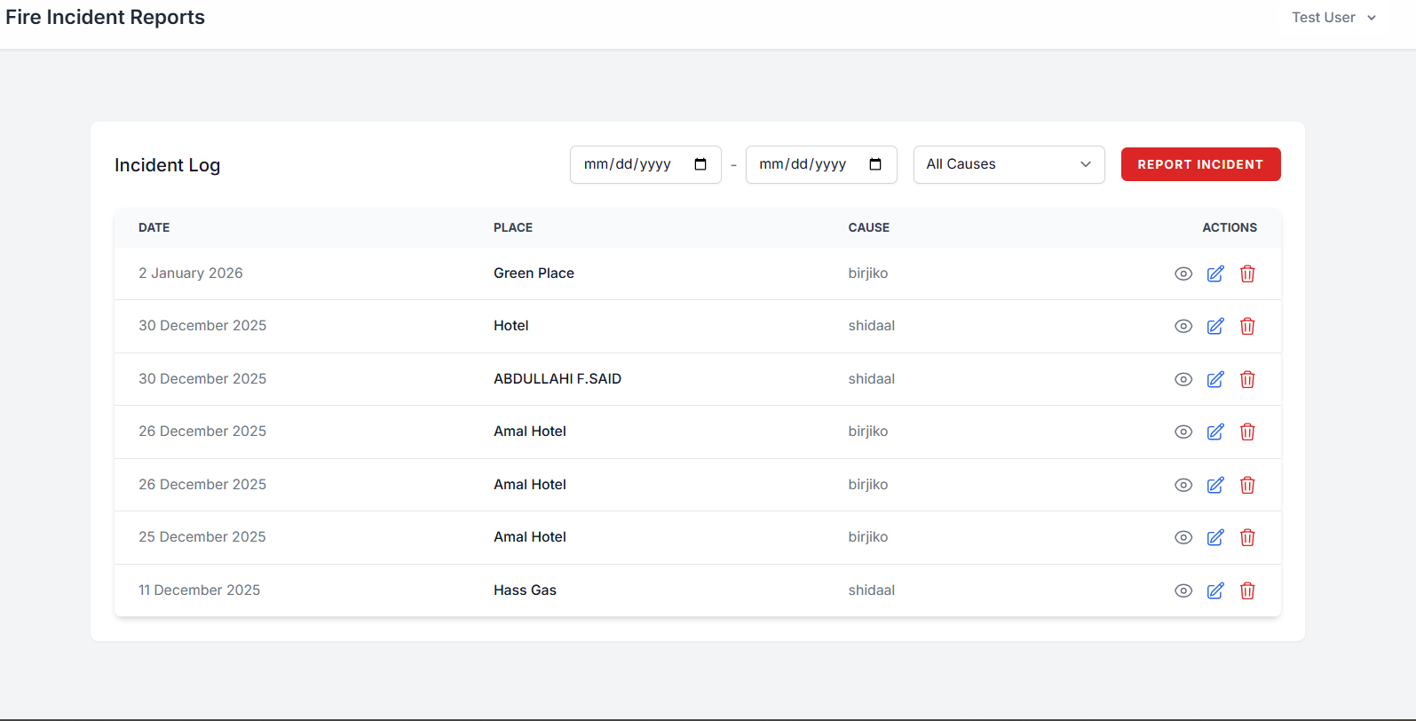
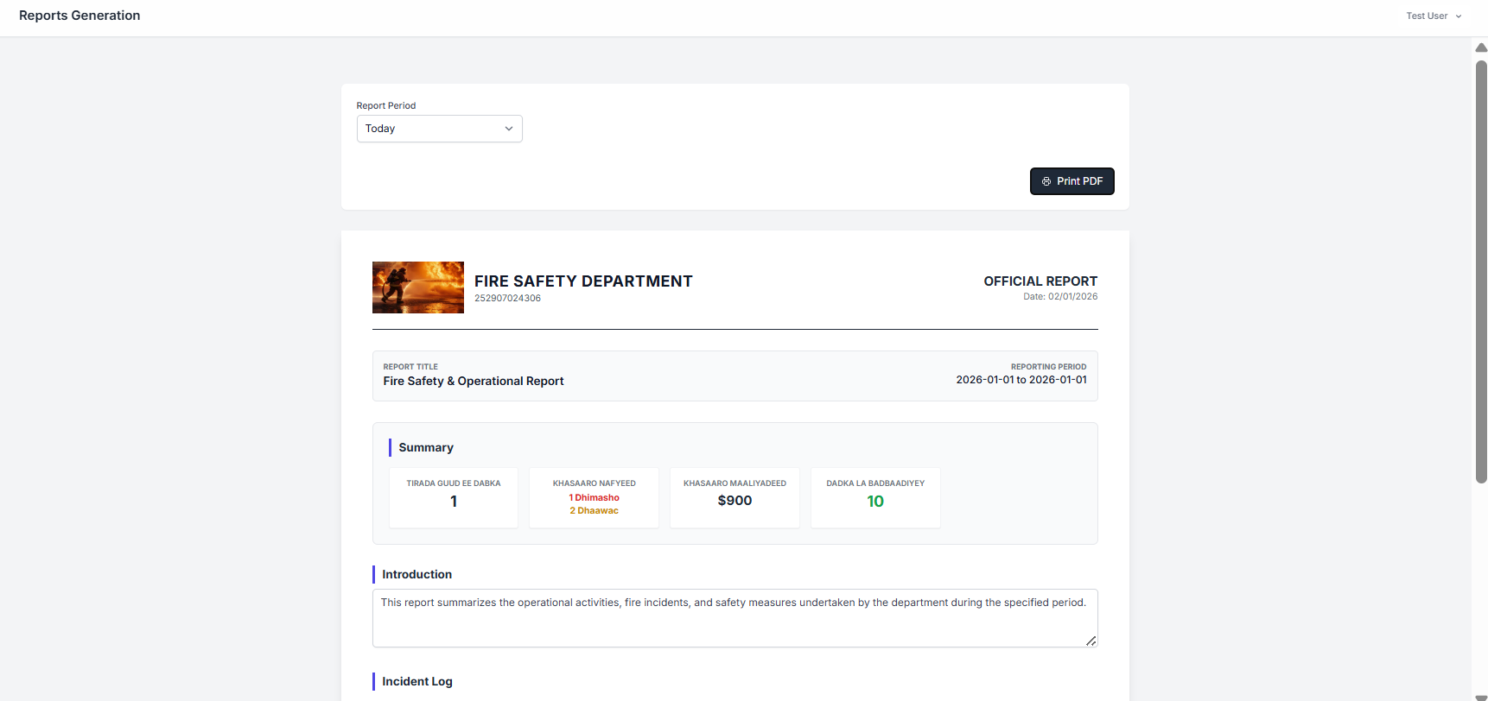
Screenshots continue.
Staff manegment
Chemical inventory
fire incident reports
Reports Generation

Slide 10
CONCLUSION
Secure Your Future with Advanced Fire Safety
The Fire Safety Management System offers a holistic and modern approach to fire safety, protecting your people, property, and reputation.
Proactive Risk Management
Streamlined Operations
Assured Compliance
Invest in the future of safety with our innovative solution.

Slide 11


Meet The Devolopers
Name:ibraahim Bashiir Kilwe
Title:Software Engneering
Name:Cabdalla Firin Said
Title:Software Engneering

Slide 12
END

